Slide 1



Concrete Strength Prediction
Keng Ming Cheng
University of California, Los Angeles (UCLA)
Contact: kengming_cheng@outlook.com
Physics of AmoRphous and
Inorganic Solids Laboratory

Slide 2
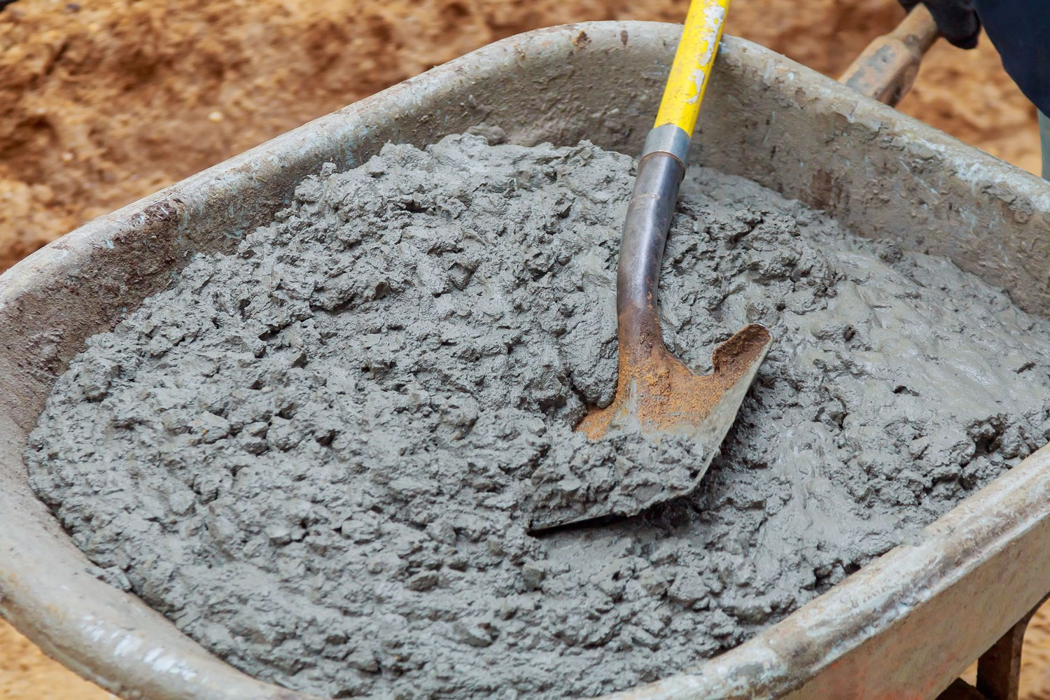
Motivation
Concrete Strength Prediction & Optimization
> Some of formulas for Civil Engineering are based on empirical equations, especially computing concrete mixtures.
> Using the Machine Learning technique to accurately predict true strength and determine the importance of each ingredient
> Here, we use machine learning to discover concrete compositions of design strength with lowest cost
Design space

Slide 3

Methods
Deep Learning
Several hidden layers (from 1 to 4) model with 32 neurons on each.
Activation function: elu
Optimizer: Adam
Using interpolated datas to calculate gradients and determine the contributions of each feature
Design space

Slide 4
Methods
Current Issues of my Research
Replicating the result from SHAP library (have to figure out how they calculate the baseline)
Baseline selection
Determining the path for the gradient
Tuning the activation function and the model complexity
Design space

Slide 5
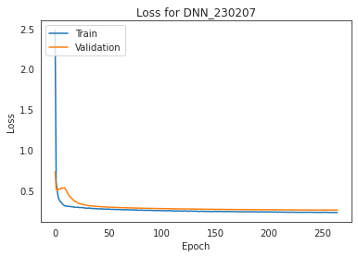
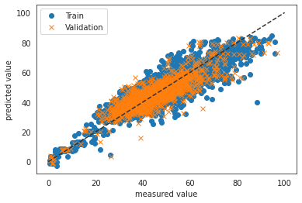
Results
Predicting Models
Loss History of DNN while training
Predicted vs Observed value

Slide 6
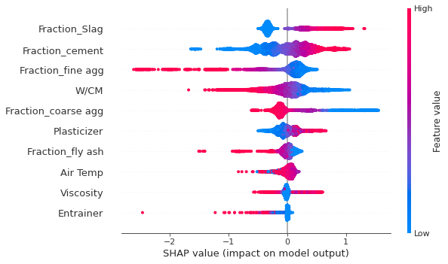
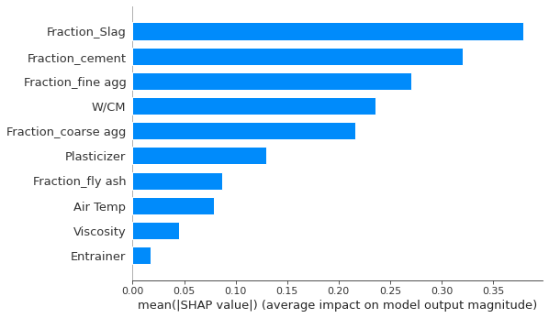
Results
SHAP Analysis of Model
SHAP scatter plot
SHAP bar plot
cv_r2: 0.7282413981763707
-------------------------
train_r2: 0.7641948152852962
> 1 hidden layer

Slide 7
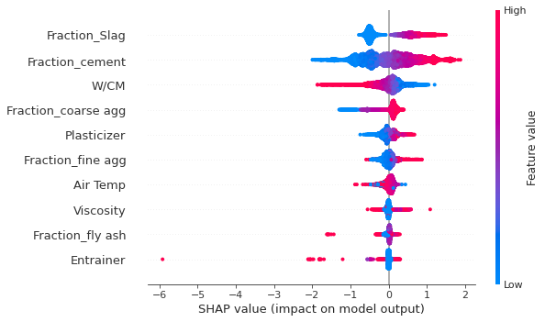
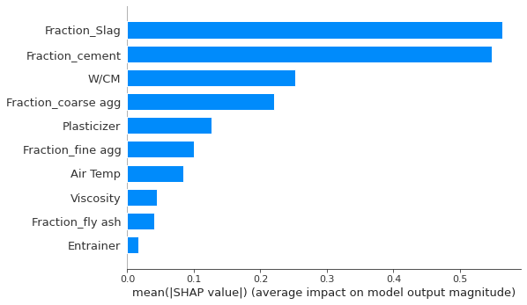
Results
SHAP Analysis of Model
SHAP scatter plot
SHAP bar plot
cv_r2: 0.7383458106607967
-------------------------
train_r2: 0.7746226524702451
> 2 hidden layers

Slide 8
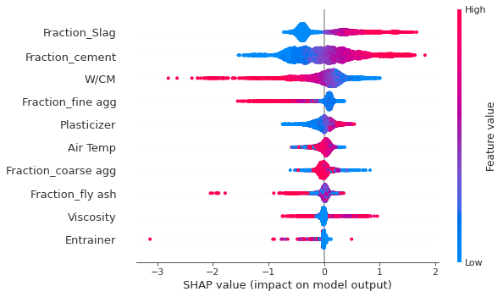
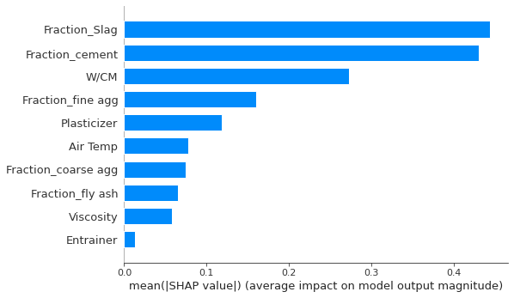
Results
SHAP Analysis of Model
SHAP scatter plot
SHAP bar plot
cv_r2: 0.7558850868236909
-------------------------
train_r2: 0.7956756220422627
> 3 hidden layers

Slide 9
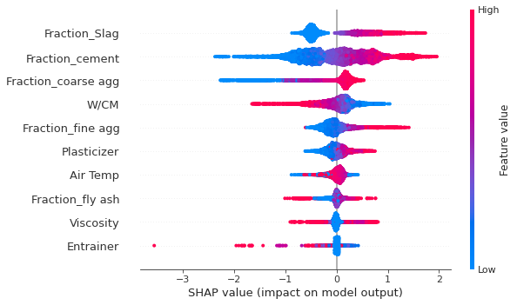
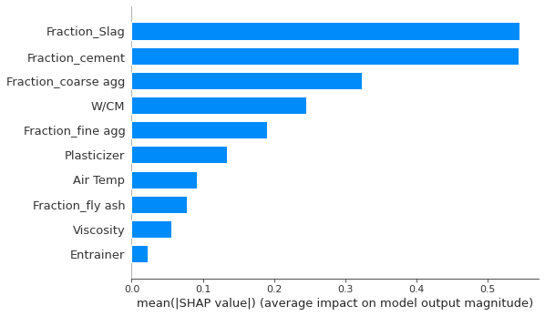
Results
SHAP Analysis of Model
SHAP scatter plot
SHAP bar plot
cv_r2: 0.7593066110123973
-------------------------
train_r2: 0.7995980900164388
> 4 hidden layers

Slide 10
Results
Comparison of Models
 | 1 hidden layer | 2 hidden layers | 3 hidden layers | 4 hidden layers
CV r2 | 0.7282 | 0.7383 | 0.7558 | 0.7593
Training r2 | 0.7642 | 0.7746 | 0.7956 | 0.7996
Most important features based on SHAP | Slag | Slag | Slag | Slag
 | Cement | Cement | Cement | Cement
 | Fine agg | W/CM | W/CM | Coarse agg.
 | W/CM | Coarse agg. | Fine agg. | W/CM
 | Coarse agg. | Plasticizer | Plasticizer | Fine agg.

Slide 11
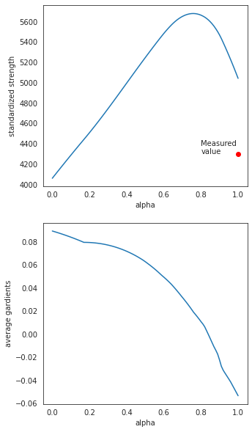
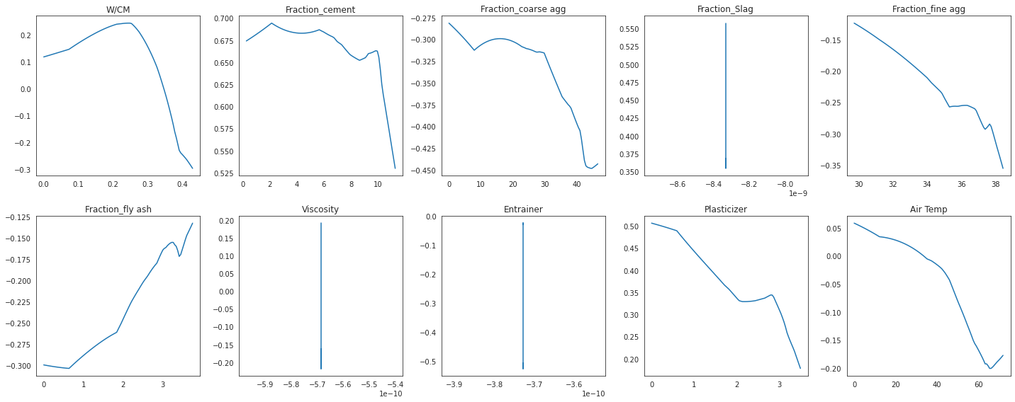
Results
Prediction of Concrete Mechanical Properties
1 hidden layer

Slide 12
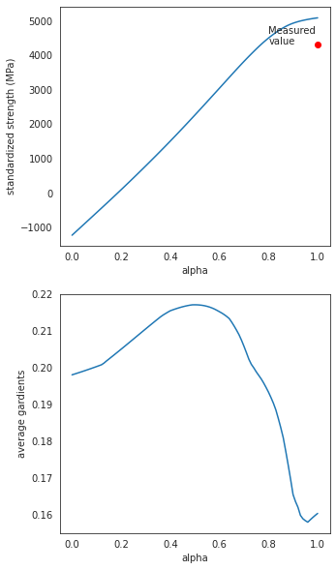
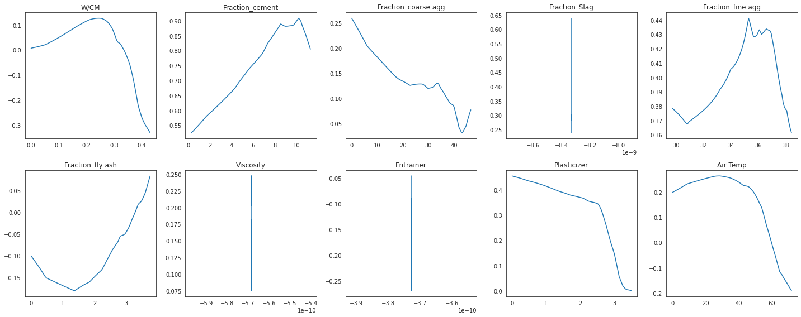
Results
Prediction of Concrete Mechanical Properties
2 hidden layers

Slide 13
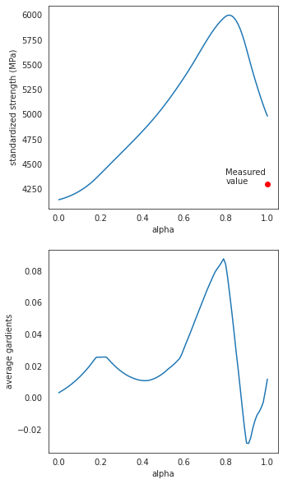
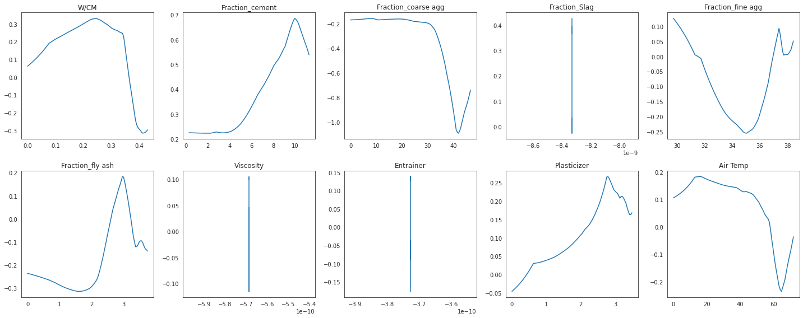
Results
Prediction of Concrete Mechanical Properties
3 hidden layers

Slide 14
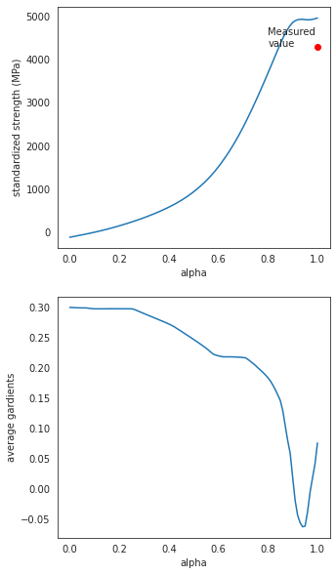
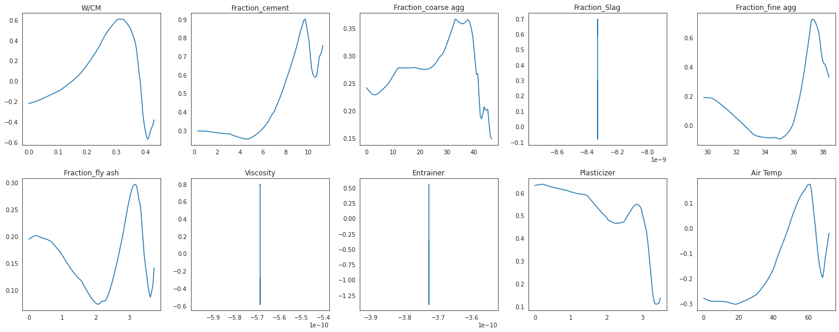
Results
Prediction of Concrete Mechanical Properties
4 hidden layers

Slide 15
Results
Prediction of Concrete Mechanical Properties
1 hidden layer
2 hidden layers
3 hidden layers
4 hidden layers

Slide 16
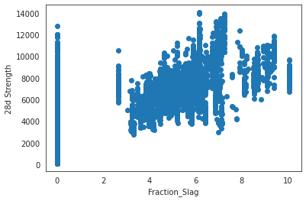
Conclusions
The highest gradients based on models are around 0.8 alpha
Slag is the most important feature from SHAP analysis, however, it’s hard to discover the relationship on the correlation plot.

Slide 17
Future Works
Replicating the result from SHAP library (have to figure out how they calculate the baseline)
Baseline selection
Determine the path for the gradient → Using optimization algorithm
Tuning the activation function and the model complexity
Determining the optimal value from gradients plot based on the optimizer.

Slide 18
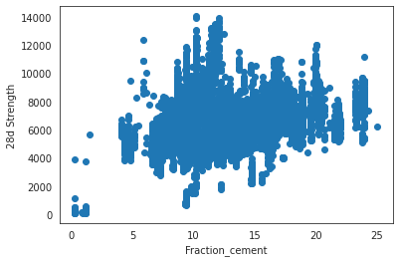
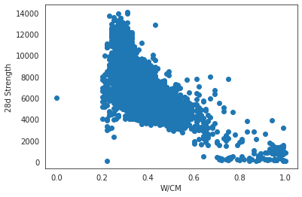
Results
Features Correlation

Slide 19
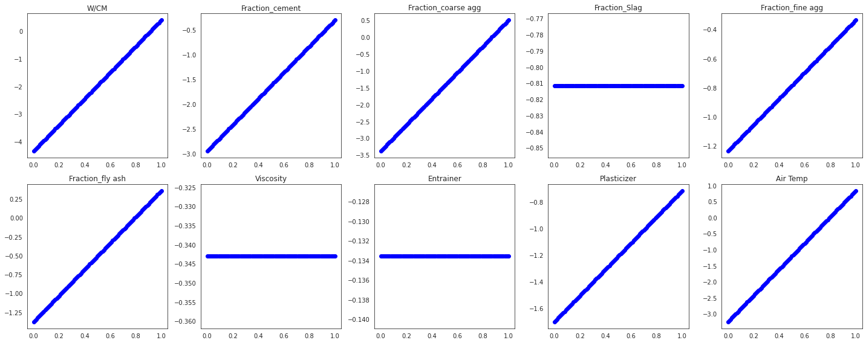
Results
Alphas vs Features

Slide 20






Thanks you!
Some references:
[1] H. Liu et al., "Machine Learning for Glass Science and Engineering: A Review” Journal of Non-Crystalline Solids X 4 (2019): 100036.
[2] R. Ravinder et al., "Deep Learning Aided Rational Design of Oxide Glasses” Materials Horizons 7 (2020): 1819-1827.
[3] H. Liu et al., "Predicting the Dissolution Kinetics of Silicate Glasses by Topology-Informed Machine Learning” npj Materials Degradation 3 (2019): 1-12.
Contact:
kengming_cheng@outlook.com
Funding acknowledgement:
Notes:
Thank sponsors

Slide 21
Notes:
Thank sponsors

Slide 22
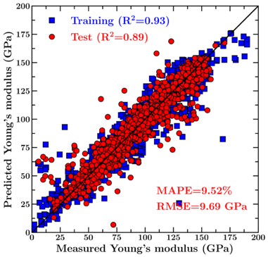
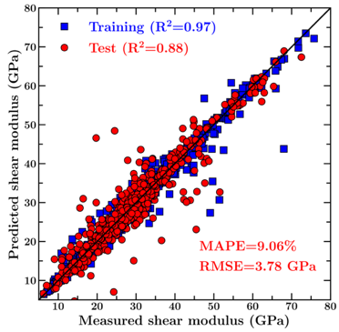
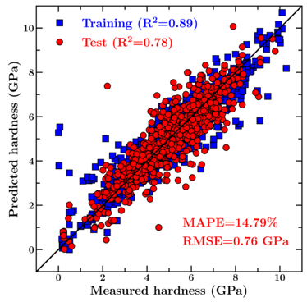
Results
Prediction of Concrete Mechanical Properties
Young’s modulus
Shear modulus
Hardness
> Our model offers a very good prediction of the mechanical properties of test set glasses (which are kept invisible to the model during its training).

